Slide 1
Low Delay Implementation

Slide 2
Specification
Current Specification
1080P@60fps
5Mbps~10Mbps
Extended
4K@30fps

Slide 3
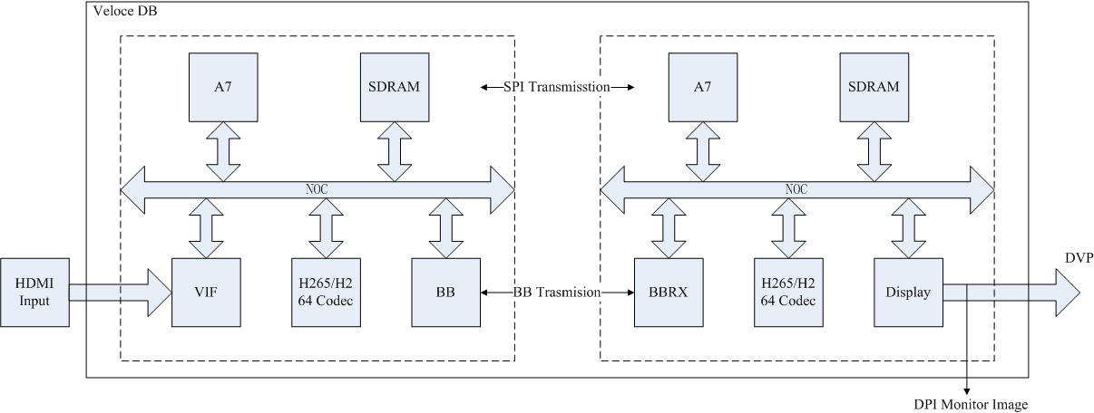
Veloce DB Requirements
Stage1
SPI transmission is used to substitute BB transmission, only for video evaluation.

Slide 4
Veloce DB Requirements
Stage2
Delay Monitor

Slide 5
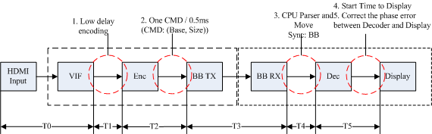
Key points
1. Low delay encoding: confirmed
2. Send cmd to BB( 1CMD/0.5ms): confirmed
3. Send cmd to Dec: need try
Need confirmed:
dec wrptr can be updated any time? Or interrupt to update it.
Sps/pps need 1024 bytes? If need 1024, sps/pps + padding zero can work?
How to flush decoder finish one frame if the rest bytes is not enough(such 3 bytes)?
Does slice affects the intra refresh?
Scheme:
BB sync the cmd → CPU parser the block and move the data into sram → inform to decoder
4. The start point of starting display: need try
Scheme:
Start timmer after launch decoding the FIRST frame→ 4 ms → launch display
5. Correct the phase error betweeen decoder and display
Need confirmed
Display can update the blank time to adjust the display vsync point
Scheme:
If the phase error > 2ms, then update blank time to adjust vsync point.

Slide 6
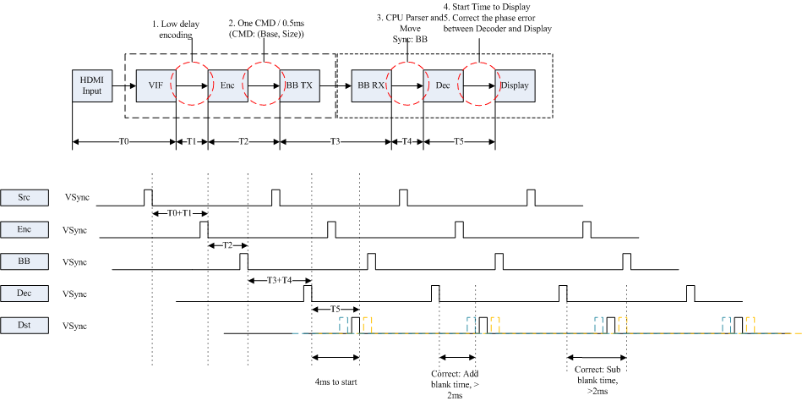

Slide 7
Question list
1. Audio/Video sync up metod
2. Error control flow on BB & Code Side
3. external HDMI TX chip bring up
4.

